Slide 1
Realization of gates
By sravanthi
Chipweave technologies pvt lmd

Slide 2
Contents
Introduction
Realization of gates using NAND &NOR gates
Mux as a Buffer
Mux as an Inverter

Slide 3
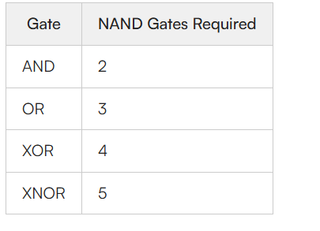
Introduction
In Boolean Algebra, the NAND and NOR gates are called universal gates because any digital circuit can be implemented by using any one of these.

Slide 4
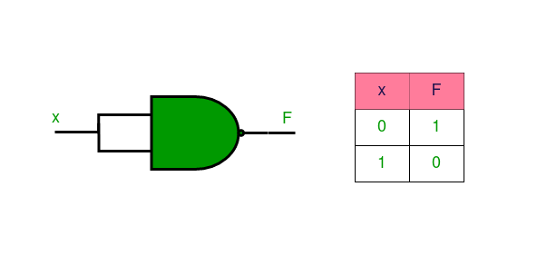
Implementation of NOT Gate using Universal gates.
Implementation NOT using NAND Gates:
A single NAND gate with joining of both inputs connected respond to a NOT gate. The NOT gate function is achieved as the result of NAND operation because the input signal is inverted.

Slide 5
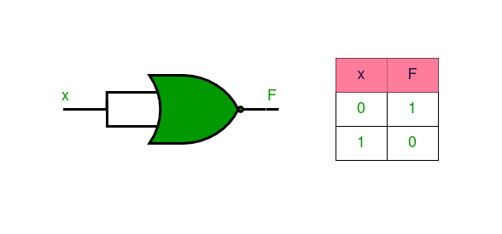
Implementation Using NOR Gates
Implementation NOT Using NOR Gates
A single NOR gate with joining of both inputs perform the function of NOT gate. The input is negated and the output thus obtained is the inversion that is characteristic of an NOT gate.

Slide 6
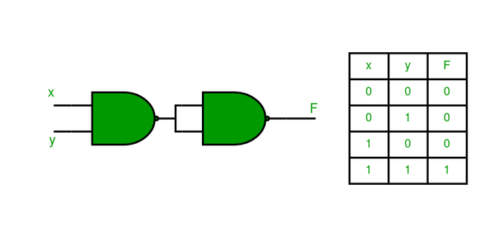
Implementation of AND Gate using Universal Gates
The AND gate is implemented using two NAND gates where the output is HIGH only when both inputs are HIGH. The first NAND gate performs a standard NAND functions, the second NAND gate has both inputs tied to the output of the initial NAND gate

Slide 7
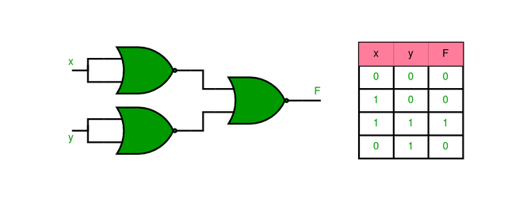
Implementation of AND Gate using Universal Gates
AND gate is implemented using three NOR gates and the setting of this Gate is referred to as 111. The inputs are then transformed with the use of a NOR gate and then they are negated one more time by using two more NOR gates

Slide 8
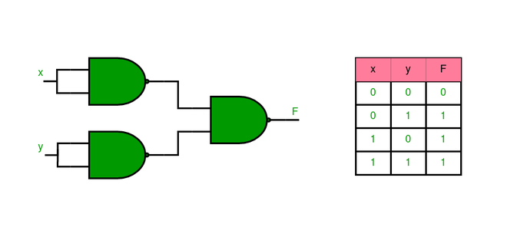
Implementation of OR Gate using Universal Gates
Implementation OR Using NAND Gates
It is implemented using three NAND gates. The inputs are first inverted using two NAND gates having their inputs probed in parallel and then the inverted outputs are connected with the input of third NAND gate. The last NAND gate effectively performs the inverted signals to give the required OR gate function

Slide 9
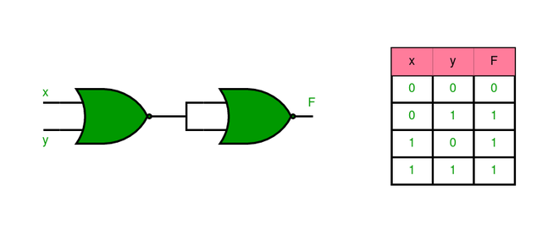
Implementation of OR Gate using Universal Gates
Implementation using NOR Gates
The OR gate is created by using an inverse of the output of the Nor operation. An inverted form of the inputs is provided directly into the NOR gate while the output is provided in NOR gate using fixed inputs

Slide 10
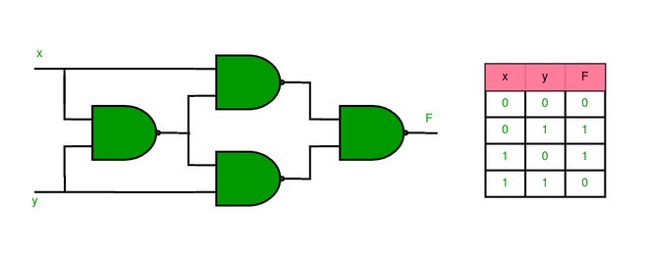
Implementation of XOR Gate using Universal gates.
Implementation using NAND Gate:
XOR gate can be implemented using four NAND gates as illustrated below. The circuit first detects differences between inputs and processes them to produce the XOR function.

Slide 11
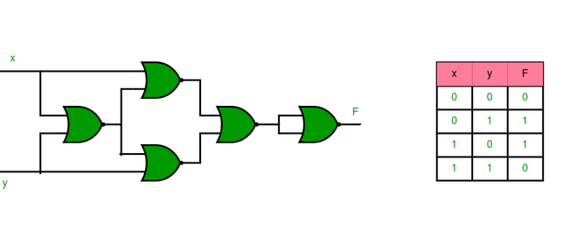
Implementation of XOR Gate using Universal gates.
Implementation Using NOR Gates
The XOR gate is implemented by five gates and these gates are the NOR gates. The inputs are then passed through a number of NOR gates to remove all the non-exclusive conditions before the XOR is applied to them.

Slide 12
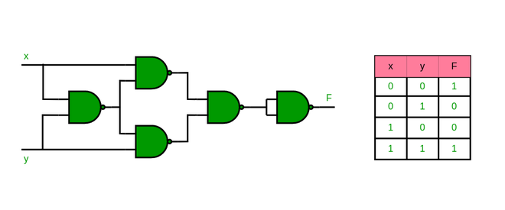
Implementation of XNOR Gate using Universal Gates
Implementation Using NAND Gate
XNOR gate is implemented by five NAND gates to make the circuit. The XOR logic is first obtained, and then the outgoing XOR signal is passed through a NAND gate that negates it to obtain the XNOR function.

Slide 13
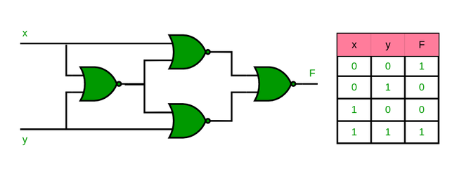
Implementation of XNOR Gate using Universal Gates
Implementation Using NOR Gate
The XNOR gate can be implemented using four NOR gates. The XOR logic is then allowed to pass through a NOR gate, and the logic of output obtained will be the XNOR.

Slide 14
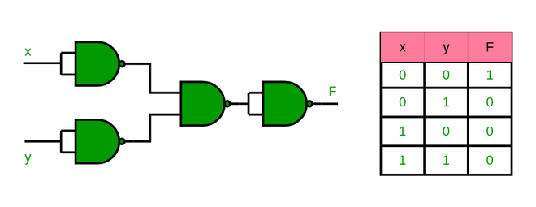
Implementation of NOR Gate using NAND Gates
NOR gate is formed by using four NAND gates. The first two gates perform the operation of inversion of inputs while the subsequent two gates perform the normal NOR operation.

Slide 15
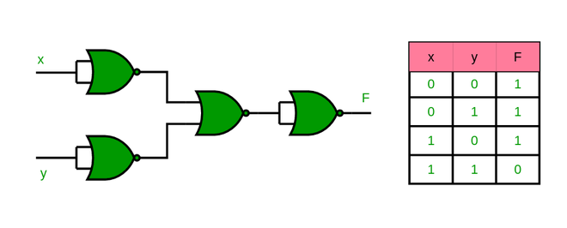
Implementation of NAND Gate using NOR Gates
The NAND gate is made using four NOR gates. The first two gates invert the inputs, and next two gates perform the operations equivalent to NAND operation by these inverted signals.

Slide 16
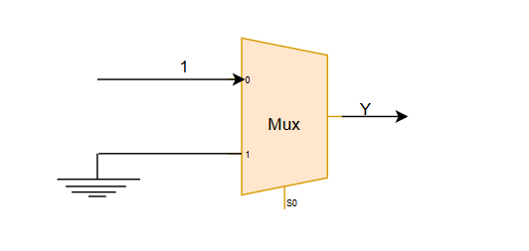
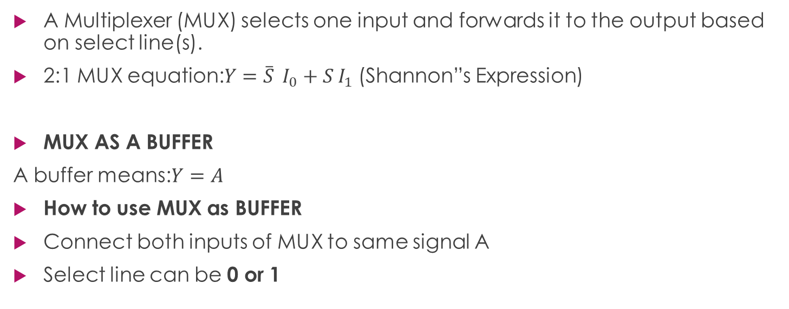
Mux as an Buffer
A Multiplexer (MUX) selects one input and forwards it to the output based on select line(s).
2:1 MUX equation:$Y=\overset{‾}{S} I_{0}+S I_{1}$ (Shannon”s Expression)
MUX AS A BUFFER
A buffer means:$Y=A$
How to use MUX as BUFFER
Connect both inputs of MUX to same signal A
Select line can be 0 or 1

Slide 17
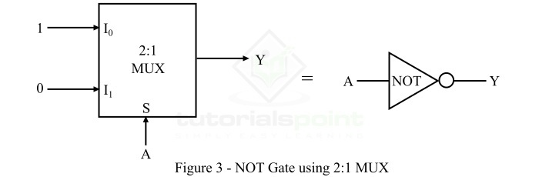

MUX AS AN INVERTER
An inverter means:$Y=\overset{‾}{A}$
Trick to get NOT using MUX
One input = 0
Other input = 1
A as select line

Slide 18
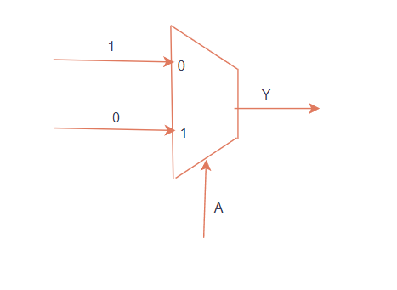
Logic gates using 2:1 mux
NOT using mux:
Y= ~A
According to Shannon’s expression
~SA+SB here S=A (selection line)
i0=1
i1=0

Slide 19
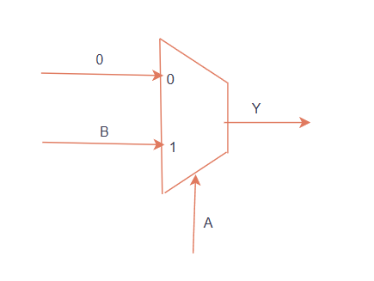
Logic gates using 2:1 mux
AND using mux:
Y= A&B
According to Shannon’s expression
~SA+SB here S=A (selection line)
input at 0 : i0=0
input at 1 : i1=B

Slide 20
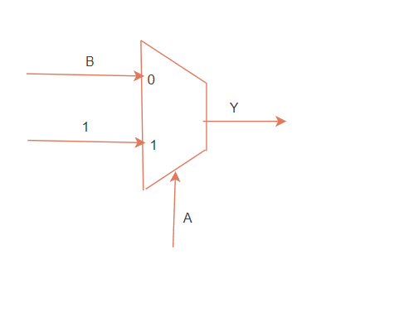
Logic gates using 2:1 mux
OR using mux:
Y= A+B
According to Shannon’s expression
~SA+SB here S=A (selection line)
input at 0 : i0=B
input at 1 : i1=1

Slide 21
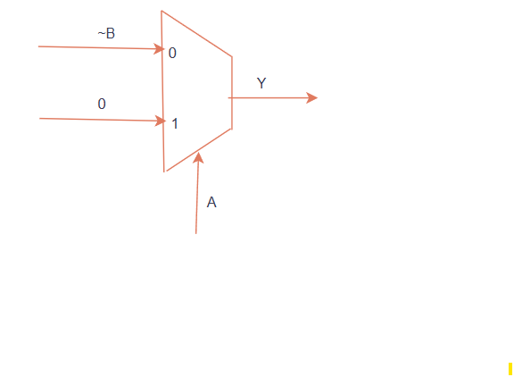
Logic gates using 2:1 mux
NOR using mux:
Y= !(A|B)
According to Shannon’s expression
~SA+SB here S=A (selection line)
input at 0 : i0=B
input at 1 : i1=1

Slide 22
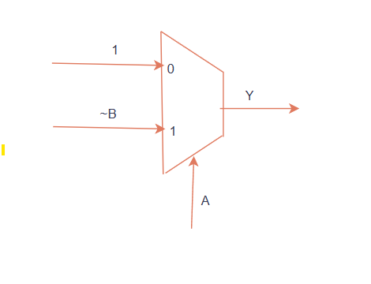
Logic gates using 2:1 mux
NAND using mux:
Y= !(A&B)
According to Shannon’s expression
~SA+SB here S=A (selection line)
input at 0 : i0=1
input at 1 : i1=~B

Slide 23
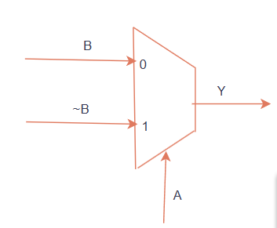
Logic gates using 2:1 mux
EXOR using mux:
Y= A^B
According to Shannon’s expression
~SA+SB here S=A (selection line)
input at 0 : i0=B
input at 1 : i1=~B

Slide 24
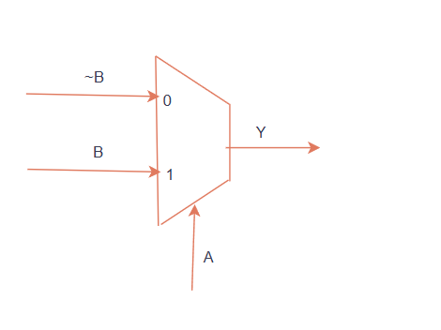
Logic gates using 2:1 mux
EXNOR using mux:
Y= ~(A^B)
According to Shannon’s expression
~SA+SB here S=A (selection line)
input at 0 : i0=~B
input at 1 : i1=B

